Slide 1
DATA TEAM · ANALYTICS WORKFLOW
Customer churn analytics
Turn a cleaned customer dataset into a repeatable workflow for churn analysis and retention conversations.

Slide 2
PROJECT FRAME
The project answers five practical questions
01
How much churn is present in the customer base?
02
Which customers show the highest customer value?
03
How are customers distributed across contract types?
04
What patterns in customer attributes may help explain retention?
05
How can stakeholders monitor indicators and decide what to investigate next?

Slide 3



01 · DATA PREPARATION
The analysis starts with a clean, analysis-ready base
One shared handoff keeps preparation, SQL, and dashboarding aligned.
492
23
DOCUMENTED
Cleaning and preprocessing documented in a Jupyter Notebook
customer records
columns prepared for analysis
Cleaned CSV
Analysis-ready
Reusable workflow
Shared handoff between preparation, SQL, and dashboarding
Consistent base for repeatable analysis
Files and steps remain connected

Slide 4
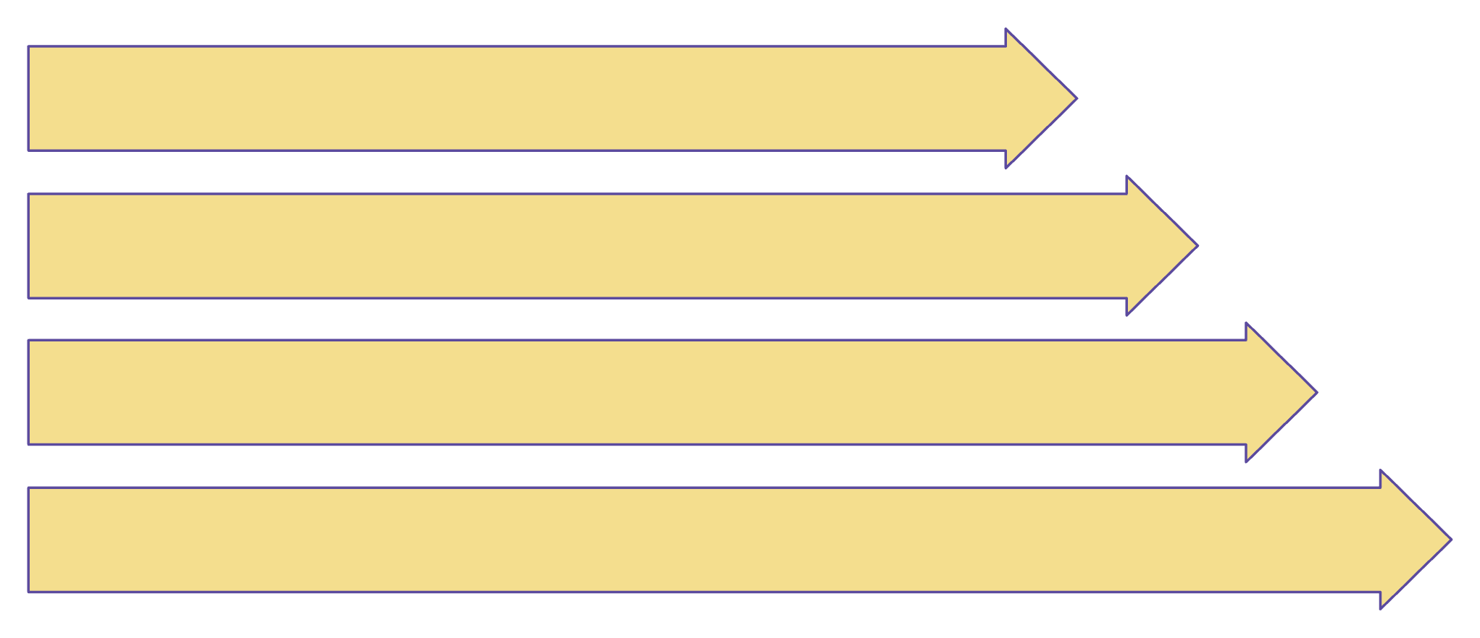
02 · WORKFLOW
One workflow connects Python, MySQL, and Power BI
Each tool has a distinct job, with documentation carrying the work forward.
Inspect & Clean Data
Query Metrics in MySQL
Build Power BI Dashboard
Document Files & Steps

Slide 5
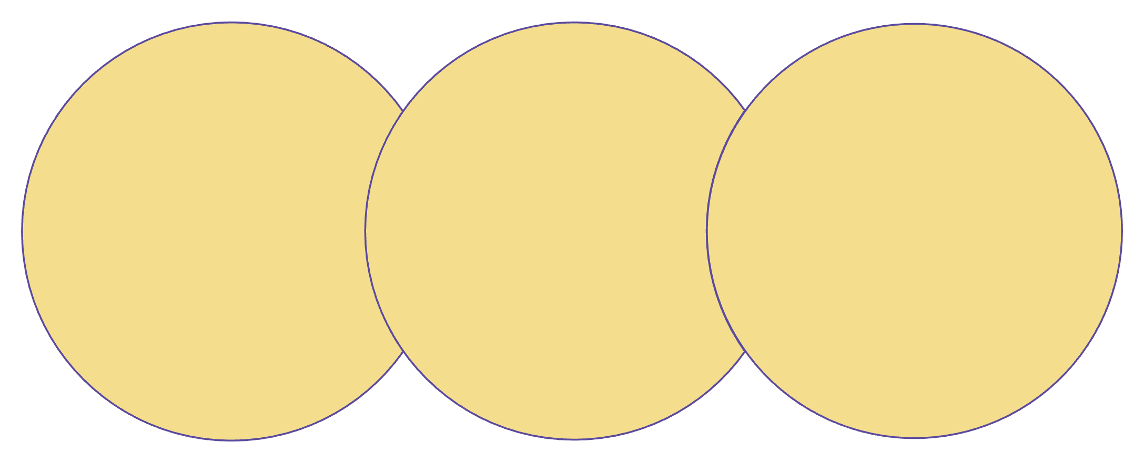
03 · CHURN BASELINE
Start with the churn baseline, then segment the question
The baseline frames the follow-up analysis without overstating what the data proves.
Overall Churn
Baseline Comparison
Interpret Signals
Calculate total churn proportion
Frame analysis by attributes and contracts
Treat patterns as investigation leads

Slide 6
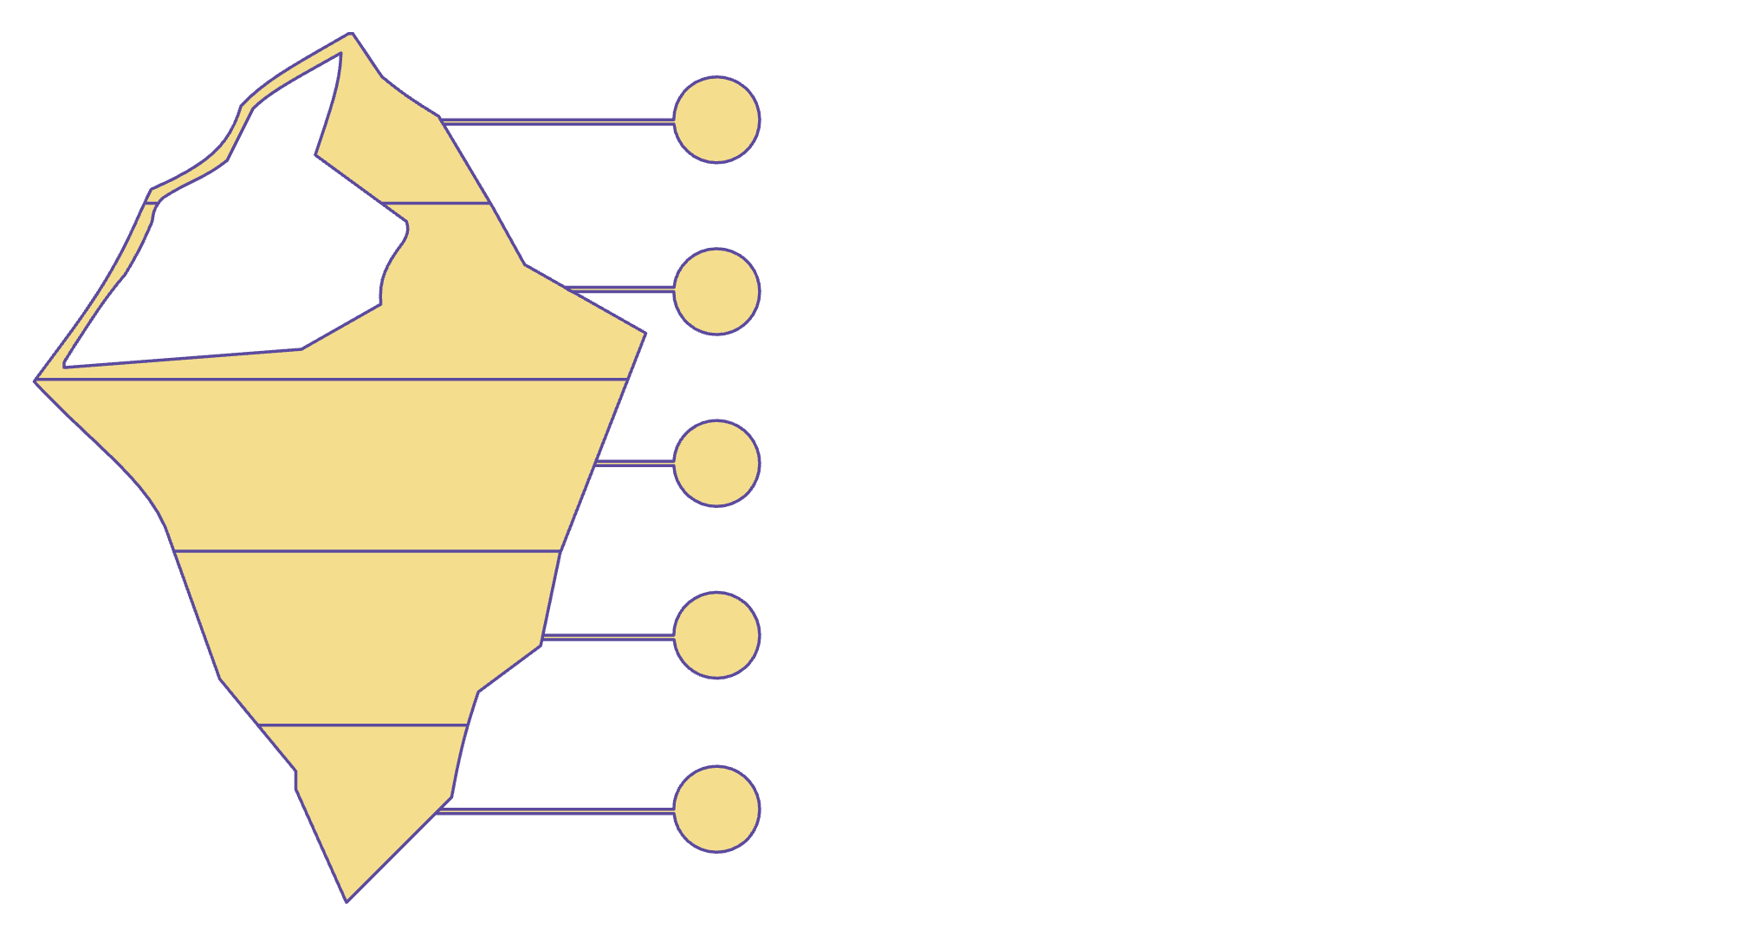





04 · CUSTOMER VALUE
Customer value helps prioritize retention analysis
Value focuses analyst attention while keeping interpretation disciplined.
Customer Value
Identify High-Value Customers
Compare Value with Churn Indicators
Focus Analyst Attention
Shape Retention Questions

Slide 7

05 · SEGMENTATION
Contract mix and customer attributes create the next cuts
Segment the baseline into questions the team can investigate next.
Customer Attributes
Analyze retention patterns by key customer attributes.
Contract Mix
Prioritized Follow‑Up
Review distribution across contract types and overlaps.
Target segments where churn, value, or mix prompt actions.

Slide 8




06 · DASHBOARD HANDOFF
The dashboard turns analysis into a retention conversation
Monitor churn-related measures and customer indicators in one interactive view
Use the dashboard to identify areas for deeper analysis and stakeholder discussion
Do not position this project as causal-driver analysis or validated predictive churn performance unless those tests are completed separately

